Slide 1

Healthcare analytics
AXON

Slide 2
TODAY’S AGENDA
GROUP MEMBERS
SUMMARY OF THE PROJECT
KPI LIST
EXCEL DASHBOARD
TABLEAU DASHBOARD
POWERBI DASHBOARD
SQL
SUGGESTIONS
KEY TAKE AWAY

Slide 3
Group members
Abhishek Kanade
Ashish Goud
Shilpa Y
Sridevi
Ayan Khan
Anush

Slide 4
Summary of the project
This project focuses on leveraging healthcare data to develop an analytical dashboard that provides actionable insights into hospital operations and patient management.
The dataset integrates multiple entities, including patients, doctors, visits, treatments, and lab results, forming a structured analytical model that reflects real-world healthcare workflows.
Through data cleaning, transformation, and KPI development in excel, the project enables comprehensive analysis across operational, clinical, and financial dimensions.
Key analytical outcomes include:
Evaluation of patient volume and visit trends over time
Identification of high-frequency diagnoses and treatment patterns
Assessment of doctor workload and resource utilization
Monitoring of laboratory performance and abnormal result rates
Analysis of treatment costs to understand financial impact

Slide 5
KEY PERFORMANCE INDICATORS LIST
Total Patients
Total Doctors
Total Visits
Average Age of Patients
Top 5 Diagnosed Conditions
Follow-Up Rate
Treatment Cost Per Visit (Avg.)
Total Lab Tests Conducted
Percentage of Abnormal Lab Results
Doctor Workload (Avg. Patients Per Doctor)

Slide 6
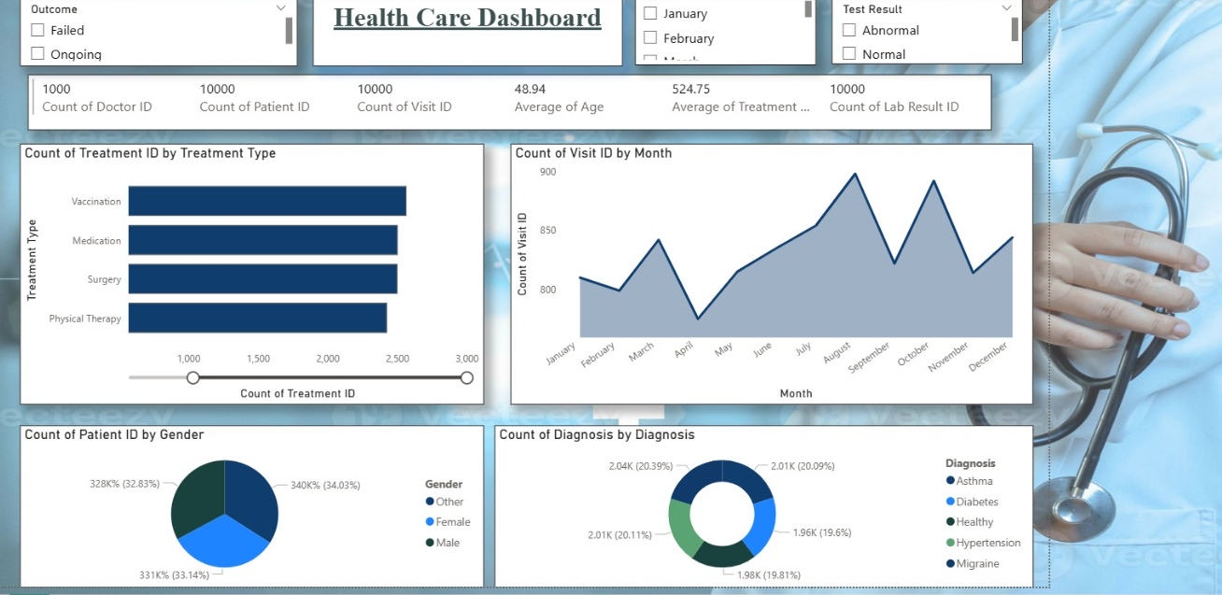
POWER BI DASHBOARD

Slide 7
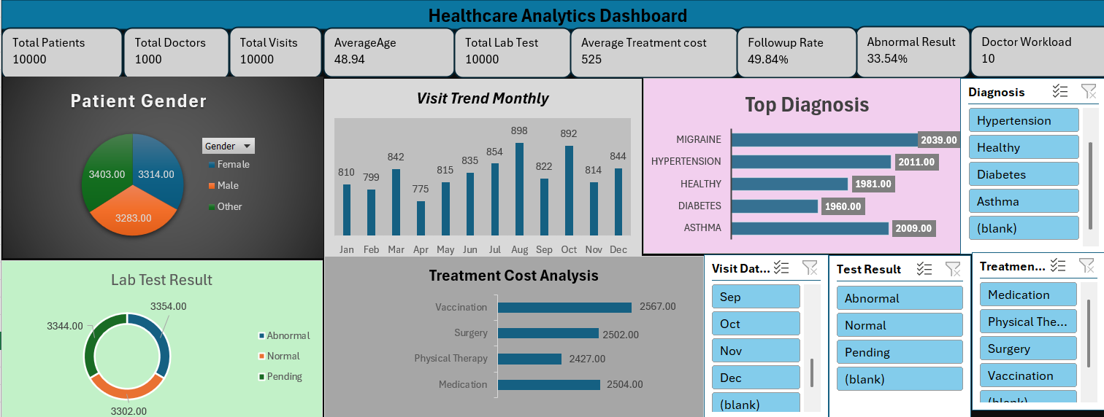
EXCEL DASHBOARD

Slide 8
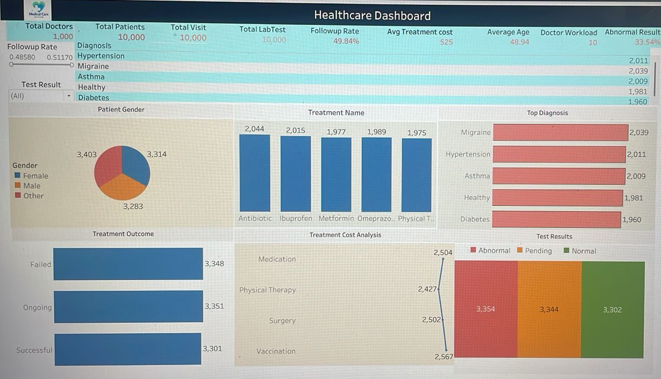
TABLEAU DASHBOARD

Slide 9
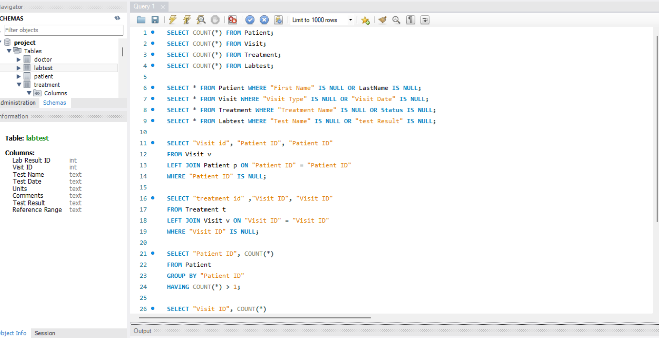
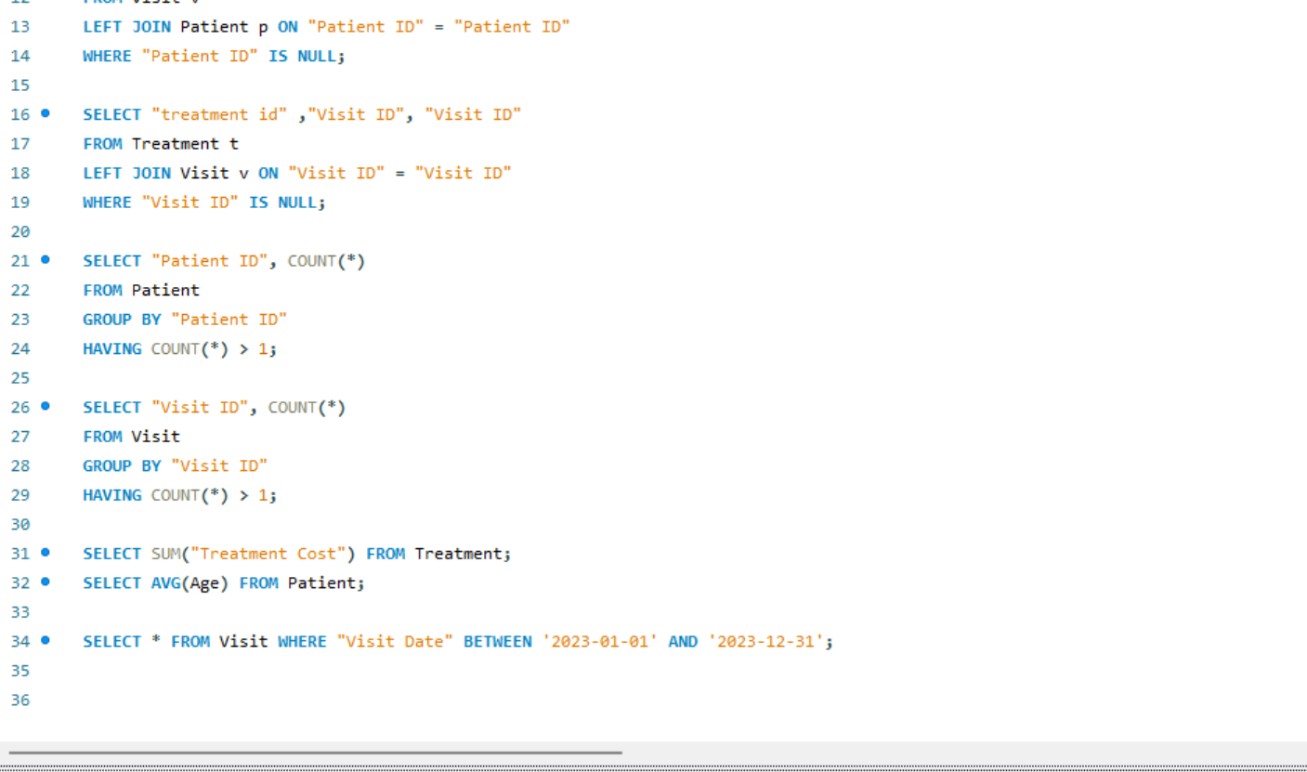
SQL SCRIPT FILE

Slide 10
SUGGESTIONS
Optimize Resource Allocation:
Leverage workload analysis to distribute patients efficiently across doctors, ensuring balanced utilization and reducing burnout risk.
Strengthen Preventive Healthcare Strategies
Focus on frequently diagnosed conditions to design preventive care programs, reducing long-term treatment burden.
Enhance Patient Follow-Up Systems
Implement automated follow-up mechanisms (SMS/email reminders) to improve treatment adherence and patient outcomes.
Improve Cost Efficiency in Treatments
Analyze high-cost procedures and introduce standardized treatment protocols to control expenses while maintaining quality of care.
Enhance Diagnostic Accuracy & Lab Efficiency
Monitor abnormal lab result trends to identify potential gaps in diagnostic processes and improve early detection mechanisms.
Streamline Patient Flow Management
Utilize visit trend analysis to optimize scheduling, reduce waiting times, and enhance patient experience.
Adopt Data-Driven Decision Framework
Institutionalize dashboard usage for continuous monitoring, strategic planning, and performance evaluation.

Slide 11
KEY TAKEAWAY
This project demonstrates the transformative impact of data analytics in the healthcare domain by converting raw clinical and operational data into meaningful insights.
The developed dashboard empowers stakeholders to:
Gain real-time visibility into hospital performance metrics
Identify patterns in patient behavior and disease trends
Optimize resource utilization, including doctors and infrastructure
Improve clinical outcomes through better monitoring and follow-up
Enhance financial planning by analyzing treatment costs
Overall, the solution highlights how data-driven healthcare systems can significantly improve operational efficiency, patient satisfaction, and strategic decision-making, laying the foundation for advanced analytics using tools like Power BI and Tableau.

Slide 12
THANK YOU

